Slide 1
Introduction to Reinforcement Learning
CSCI 8360 Data Science Practicum
Spring 2021

Slide 2
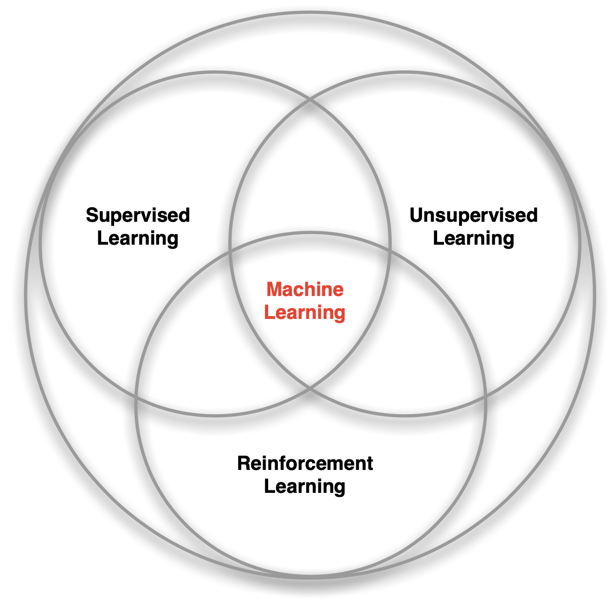
Machine Learning
Supervised learning
Learn a function f such that it maps input X to labels Y
f(X) -> Y
Unsupervised learning
Finding patterns in data without labels
Clustering, compression, dimensionality reduction
Reinforcement learning
Sequential decision-making
Combines aspects of supervised and unsupervised learning

Slide 3
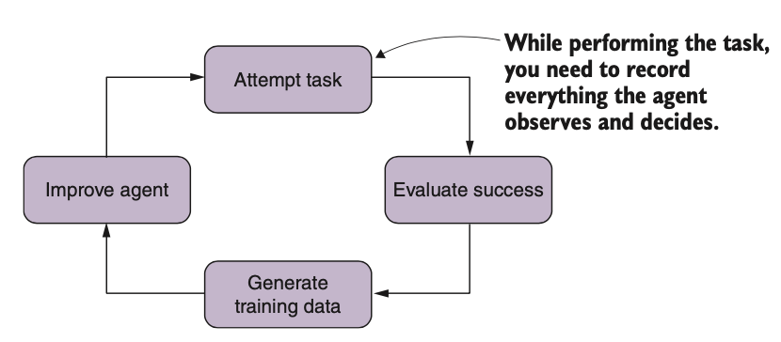
Reinforcement Learning (RL)
Key point: learns through trial-and-error interaction with the surrounding environment

Slide 4
Jargon
Agent
The “thing” that’s learning the optimal behavior through trial-and-error interaction with the surrounding environment
Environment
The explicit limiting circumstances (spatial, temporal, interactive) in which your agent can freely probe in order to learn
States
Information the agent uses to determine what to do next
A function of history, where history is the sequence of observations, actions, and rewards up to the current time t
Actions
Possible decisions an agent can make at step t
Actions will influence reward
Reward
A scalar feedback signal to the agent indicating how well it’s doing at step t
Or “return” on a policy
Policy
Defines how an agent selects actions to perform
Deterministic (direct mapping from action to state) or stochastic (probabilistic mapping)

Slide 5
Goal of RL
Select actions to maximize total future reward
(can we know the future reward?)
Actions may have long-term consequences
Reward may be delayed
May be better to sacrifice immediate reward to gain more long-term reward
Financial investments
Blocking opponent moves

Slide 6
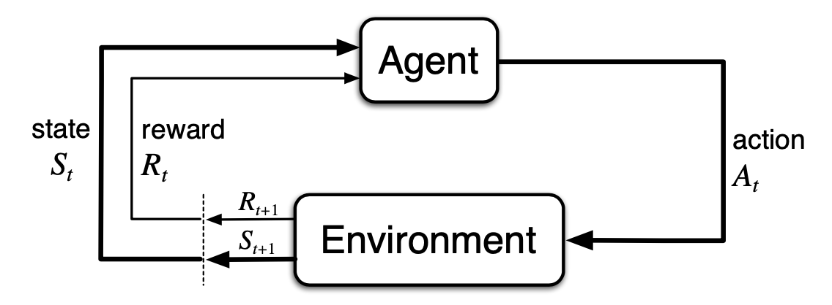
Goal of RL
The agent-environment interaction in reinforcement learning

Slide 7
Examples of Reward
These can be VERY long-term rewards!
Dependency between game outcome and any individual move is ambiguous.
Flying a drone
+ reward for following desired trajectory
- reward for crashing
Defeat world champion at chess
+ reward for winning a game
- reward for losing a game
Control a power station
+ reward for producing power
- reward for exceeding safety thresholds
Play different Atari video games
+ reward for increasing score
- reward for lower scores

Slide 8
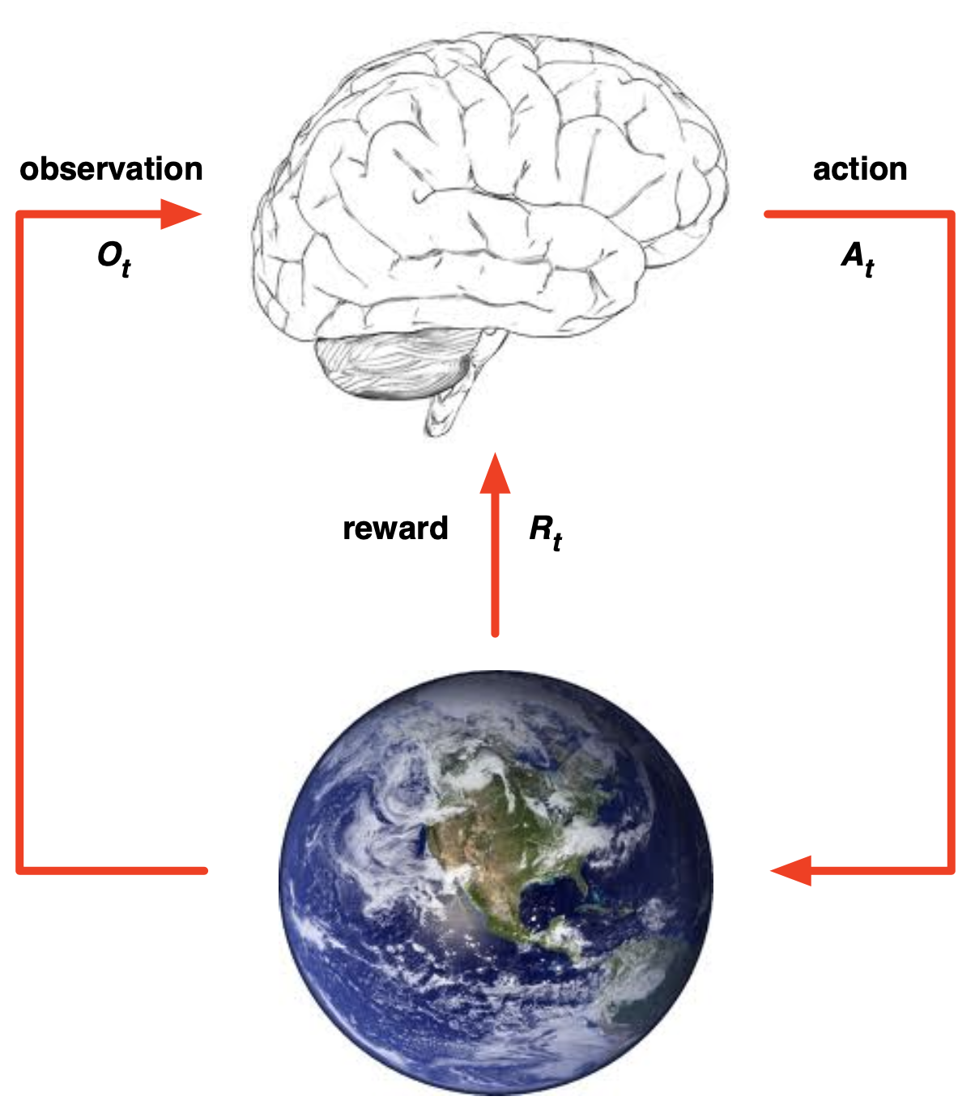
Agent and Environment
Select actions to maximize total future reward
Actions may have long-term consequences
Reward may be delayed
May be better to sacrifice immediate reward to gain more long-term reward
Financial investments
Blocking opponent moves

Slide 9
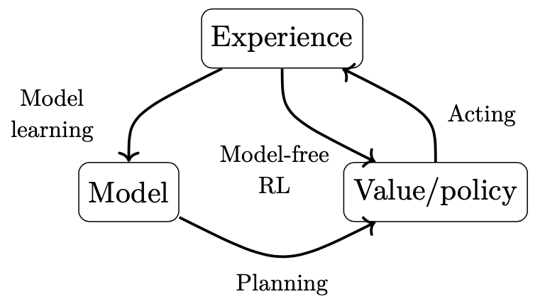
Model-based or model-free
The agent may have an internal model of the environment
Contains estimated transition function and estimated reward function
Combines these with a planning algorithm
Model-free agents optimize the reward function directly

Slide 10
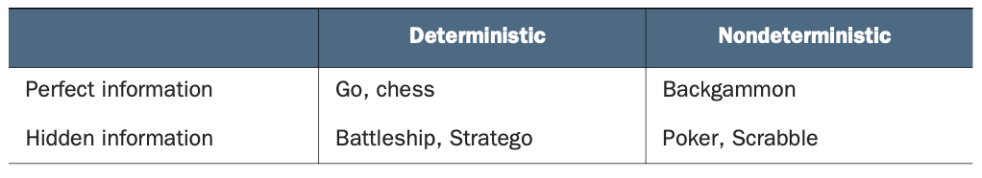
Types of Environments
Deterministic, non-deterministic
Fully-known, hidden (or partially hidden)

Slide 11
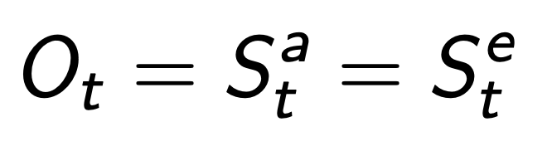
More on Environments
Full observability: agent directly observes environment state
Partial observability: agent indirectly observes environment state
A robot’s camera vision does not have absolute positional information
Trading agent only sees current market prices
Poker agent only observes public / revealed cards
Markov Decision Process (MDP)
Partially Observable Markov Decision Process (POMDP)

Slide 12
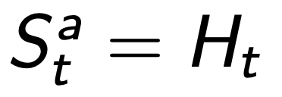
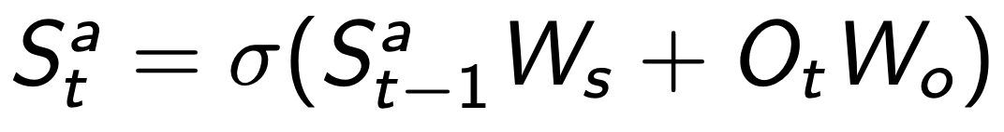

More on Environments
In POMDPs, agent must construct its own state representation $S_{t}^{a}$
Complete history
Beliefs of environment state
Recurrent neural network

Slide 13

Value Function
Prediction of future reward by the agent
Used to evaluate the goodness/badness of states, and therefore to select between actions
$π$: current policy
s: agent’s state
$γ$: discount factor (why?)

Slide 14
Value vs Reward
Value
Reward
Prediction
Evaluated in advance
Derived by the agent using the information it has on hand
Ground truth
Provided after the fact
Given by the environment once the ultimate consequences of the agent’s actions are known

Slide 15
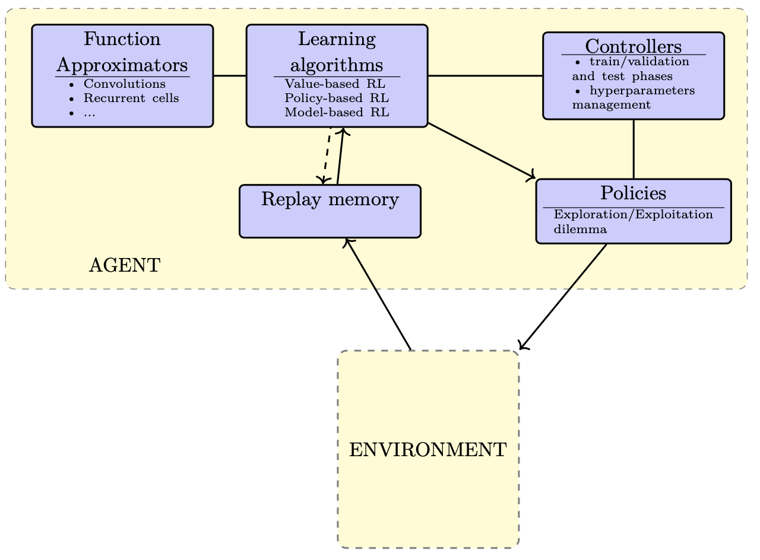
General RL schema

Slide 16
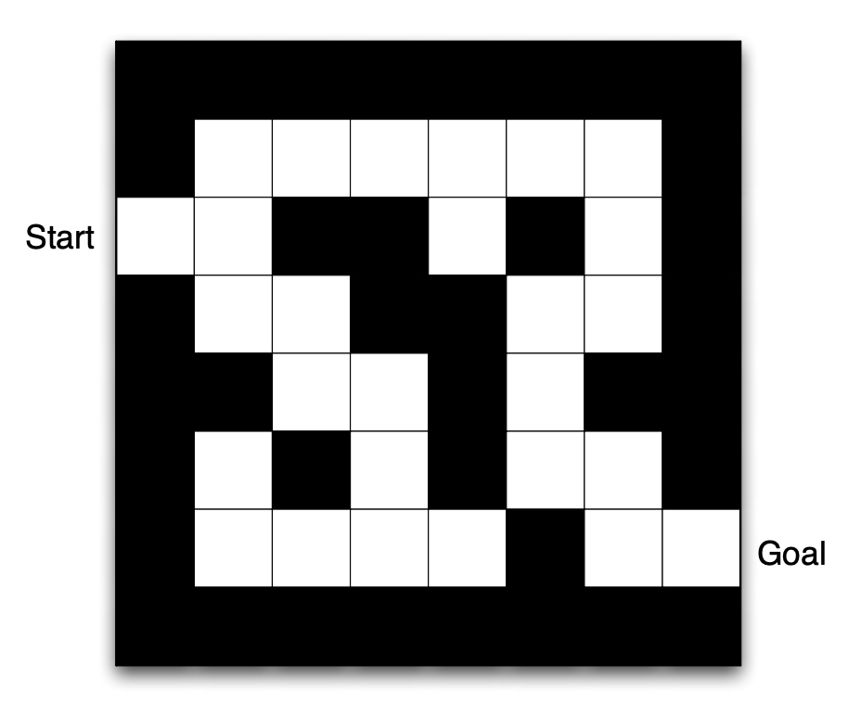
Maze Example
Rewards: -1 per step
Actions: Up, Down, Left, Right
States: agent’s location

Slide 17
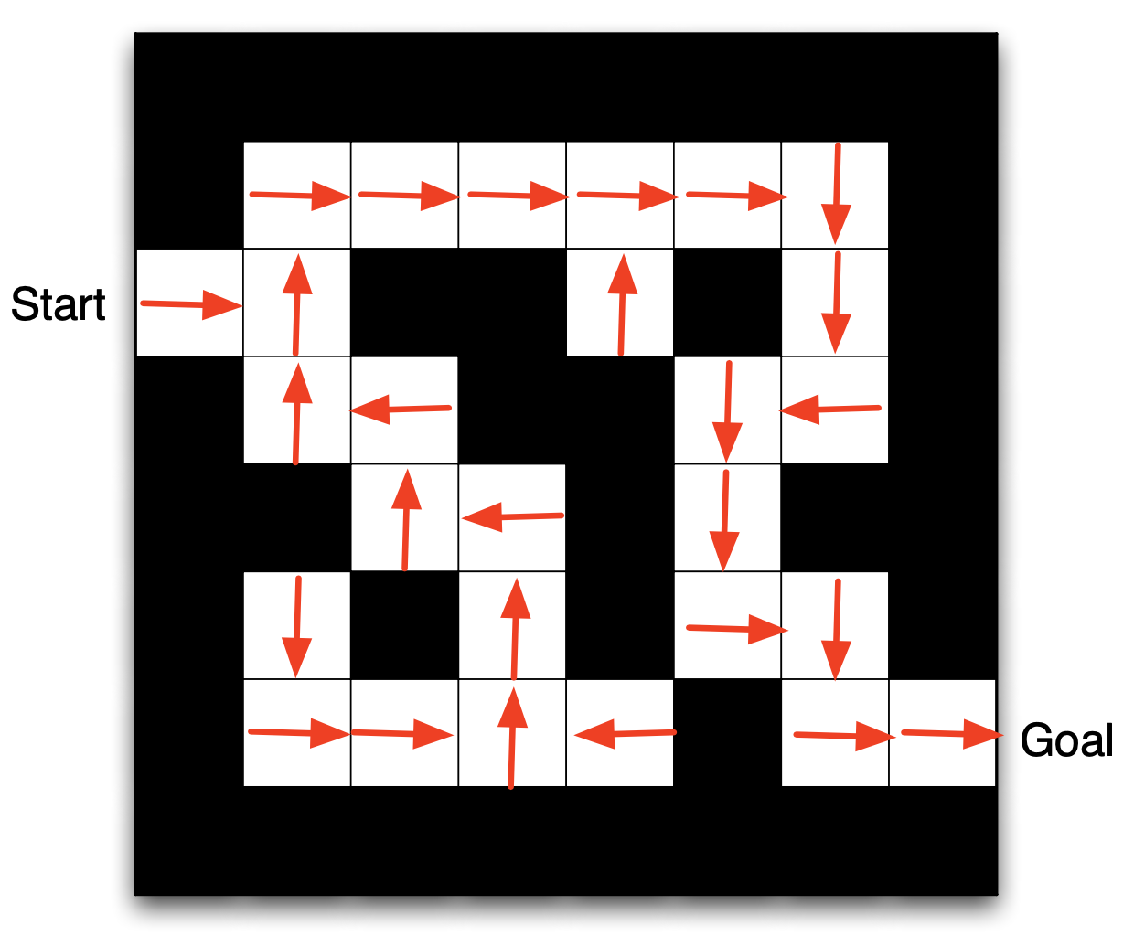
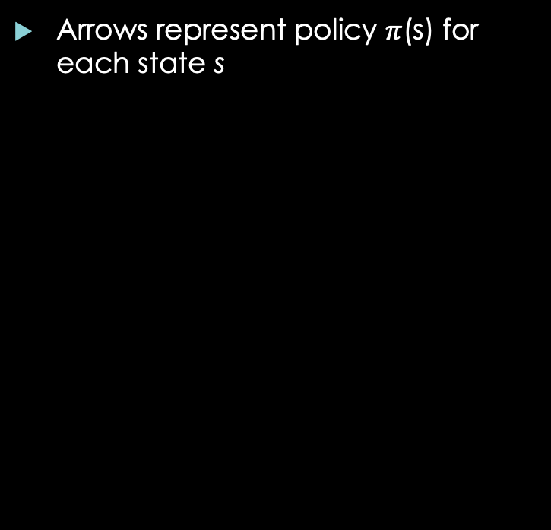
Maze Example
Arrows represent policy $π$(s) for each state s

Slide 18
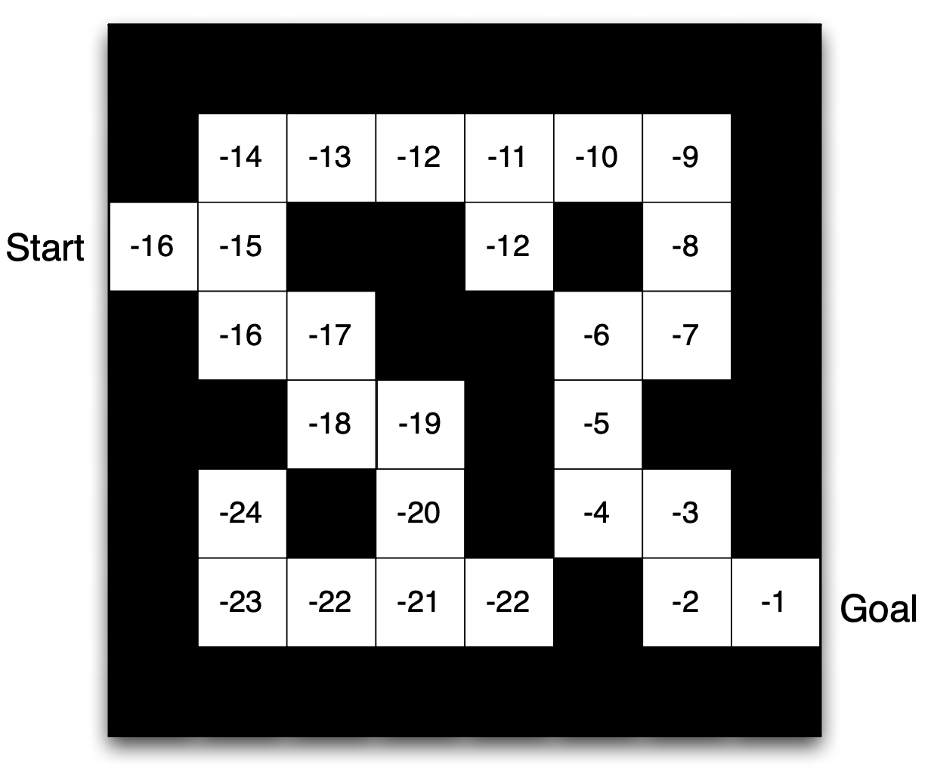
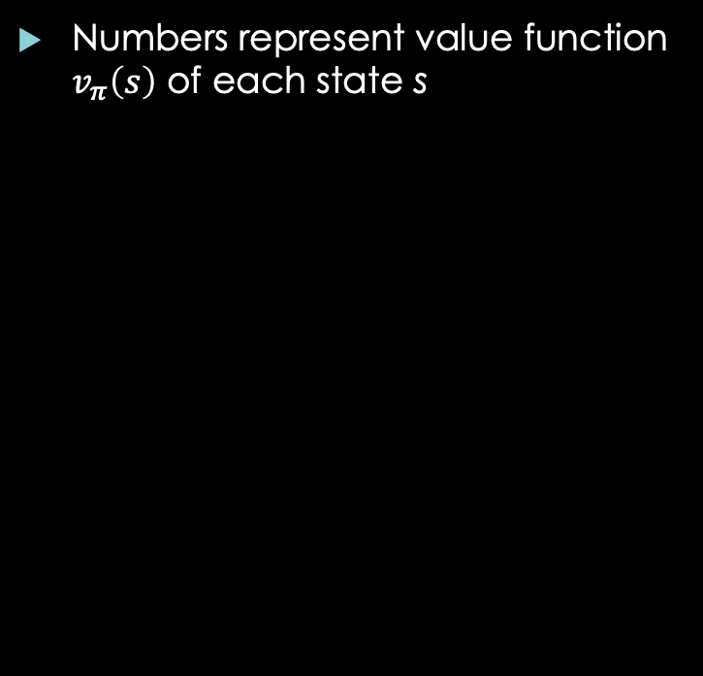
Maze Example
Numbers represent value function $v_{π}\left(s\right)$ of each state s

Slide 19
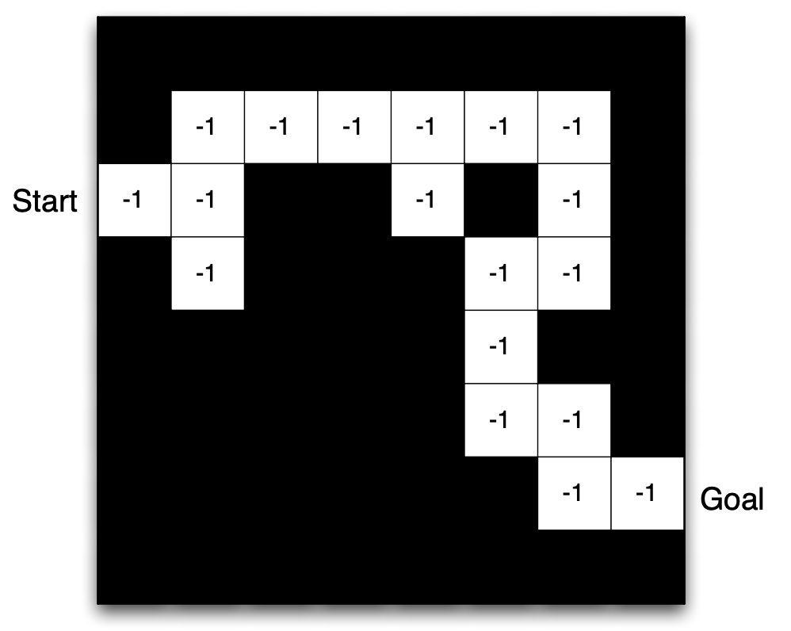
Maze Example
Agent may have an internal model of the environment
Dynamics: how actions change state
Rewards: how much reward from each state
Model may be imperfect!
Grid layout represents transition model
Numbers represent immediate reward from each state

Slide 20
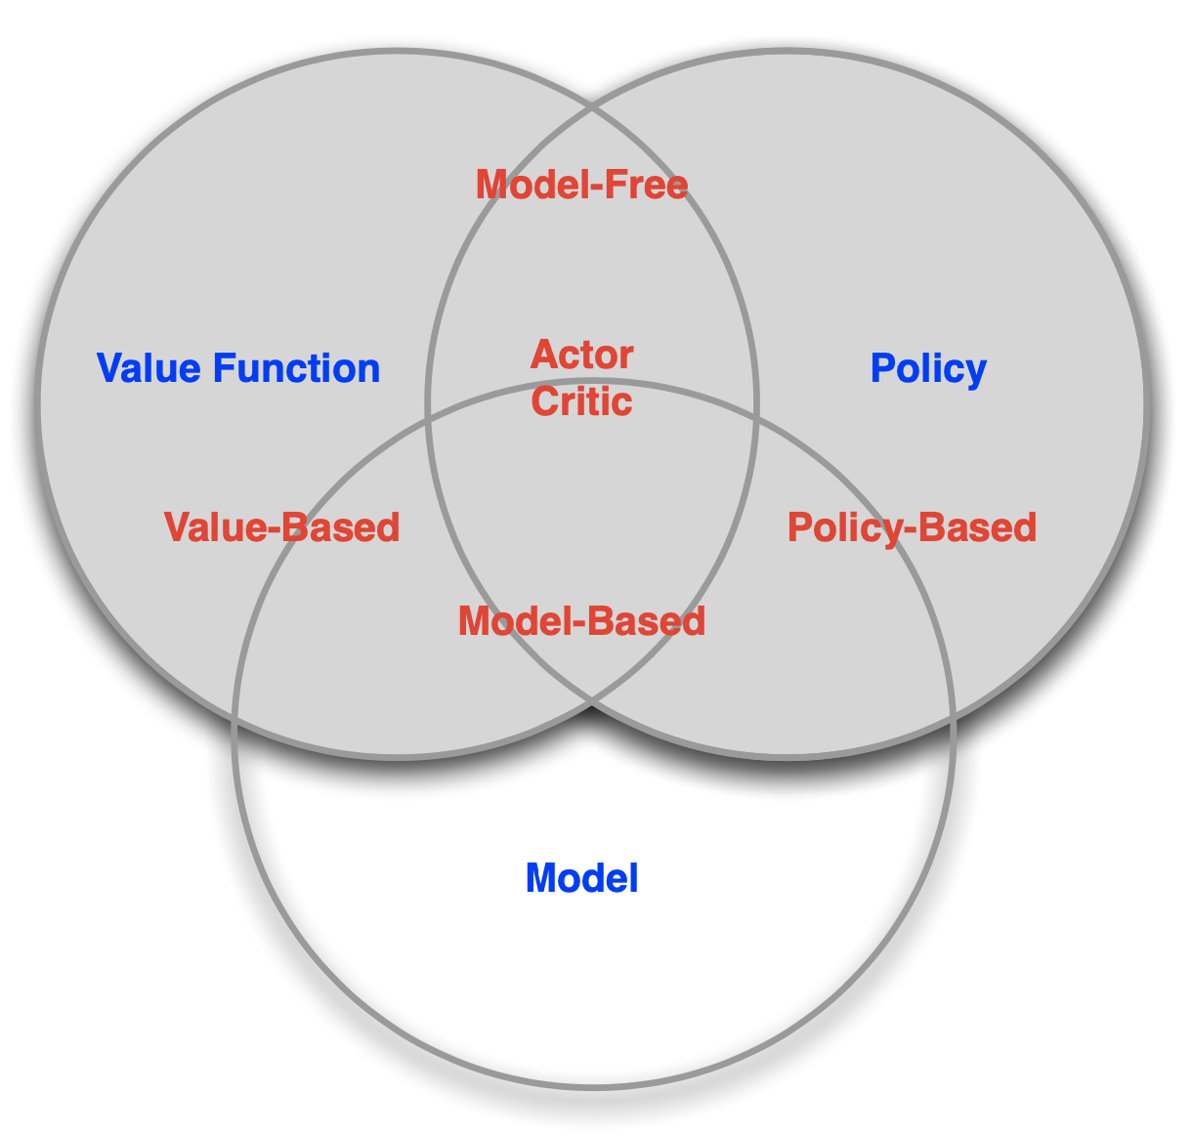
RL agent taxonomy

Slide 21
Sequential decision making
Reinforcement Learning
Planning
Environment initially unknown
Agent interacts with environment
Agent improves its policy
Model of environment is known (albeit possibly imperfect)
Agent performs computations with its model (no external interactions)
Agent improves its policy
Deliberation, reasoning, introspection, pondering, thought, search, etc

Slide 22
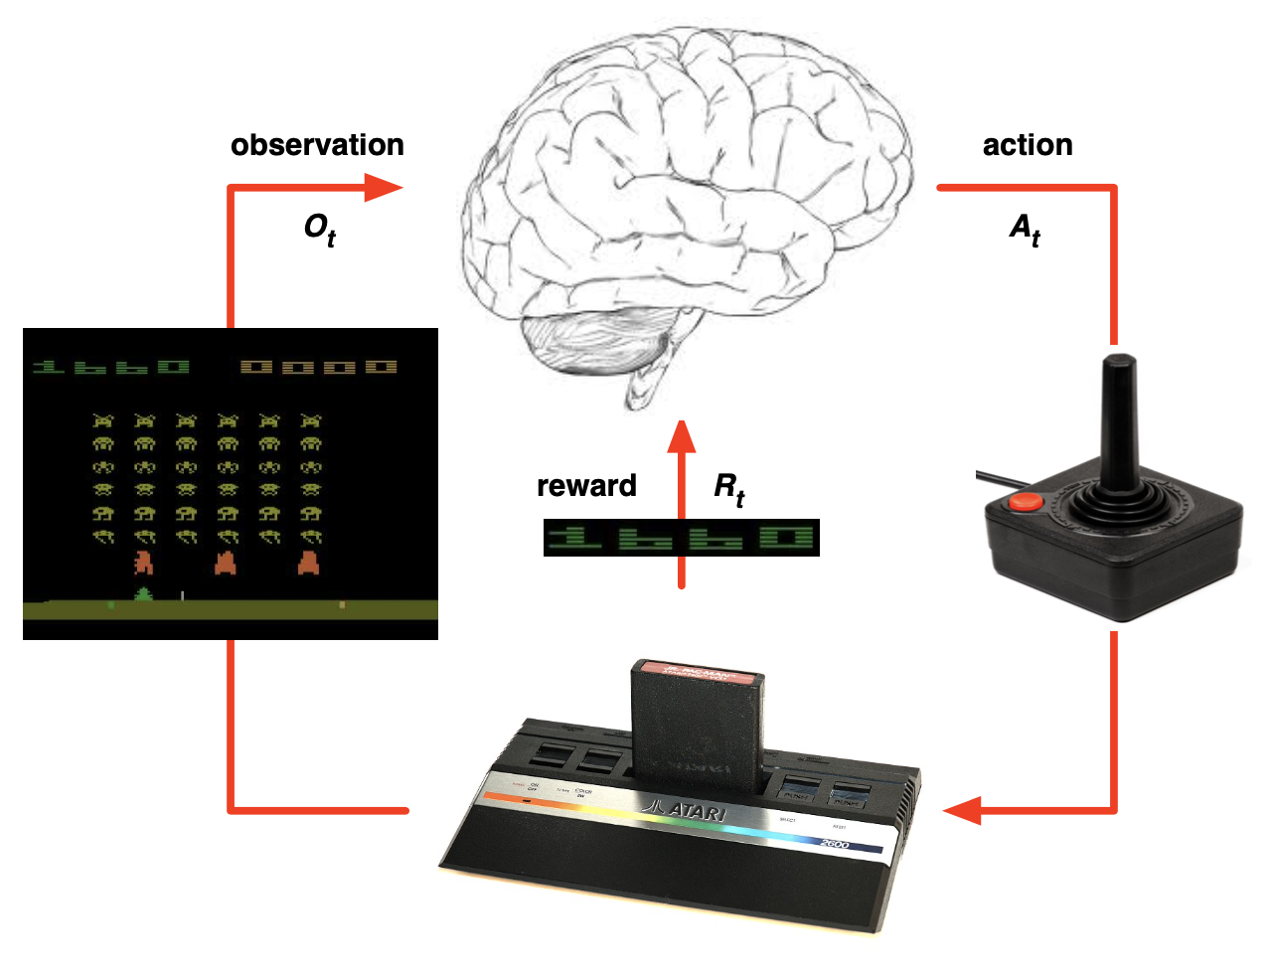
Atari Example: RL
Rules of the game could be initially unknown
Learn rules directly from interactive game-play
Pick actions on joystick, see pixels and scores

Slide 23
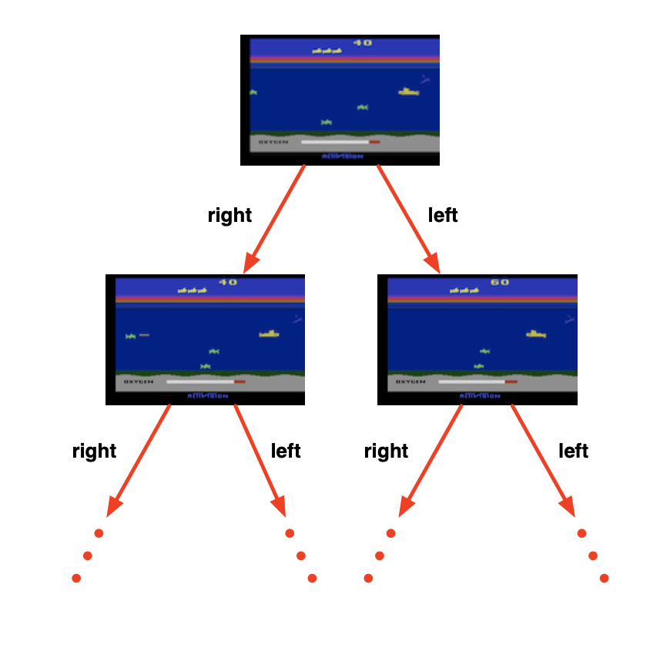
Atari Example: Planning
Rules of the game are known
Can query the emulator
In this case, a perfect model inside agent’s brain
If I take action a from state s:
What would the next state be?
What would the score be?
Plan ahead to find optimal policy
E.g. tree search

Slide 24
Two key strategies
Exploration
Exploitation
Finds more information about the environment
Try a new restaurant
Show a new ad
Play an experimental move
Exploits known information to maximize reward
Go to your favorite restaurant
Show most successful ad
Play the move you know works best
It is usually very important to do both, but one often comes at the expense of the other

Slide 25
Exploration and Exploitation
RL is like trial-and-error learning
Agent should discover a good policy via its experiences interacting with the environment
…without losing too much reward along the way

Slide 26
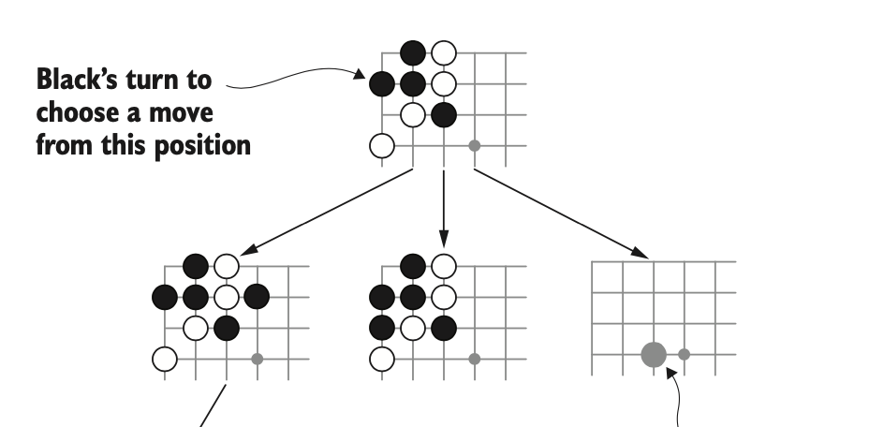
Games for RL
Why games?
[often] simple rules, but deep concepts
Very large observation and/or action spaces
Long planning horizons / sparse rewards
Fun!

Slide 27
Core approach: minimax
You have two players with two distinct policies
Assume each player enacts their optimal policy (i.e., they’re good players)
Players adapt to each other
Therefore, players have opposite rewards (what is good for one player must, therefore, be bad for the other): zero-sum rewards
Sound at all familiar?

Slide 28
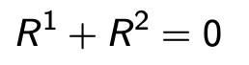
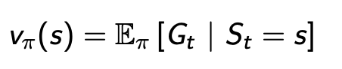
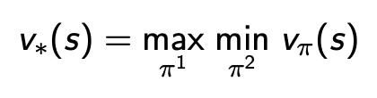

Minimax
Nash equilibria
We see this in GANs!
Value function now defines expected total reward given joint policies $π= \left\langle π^{1}, π^{2}\right\rangle$
Redefine a player’s value function as a minimax value function
Subscripts will be swapped depending on which player’s value function we’re referring to

Slide 29
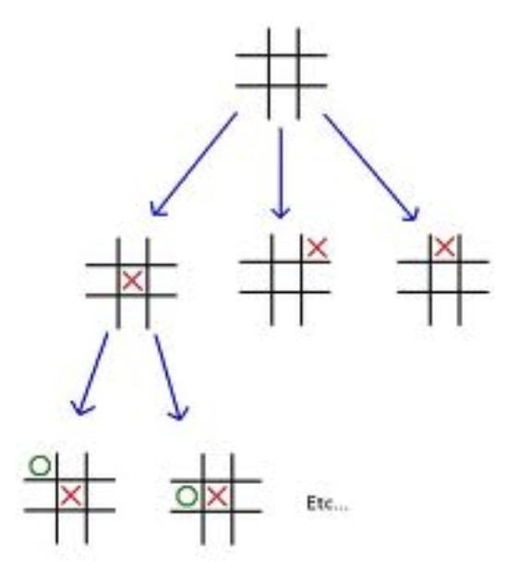
Minimax
How to find the minimax?
Depth-first game-tree search
Done! …right?

Slide 30
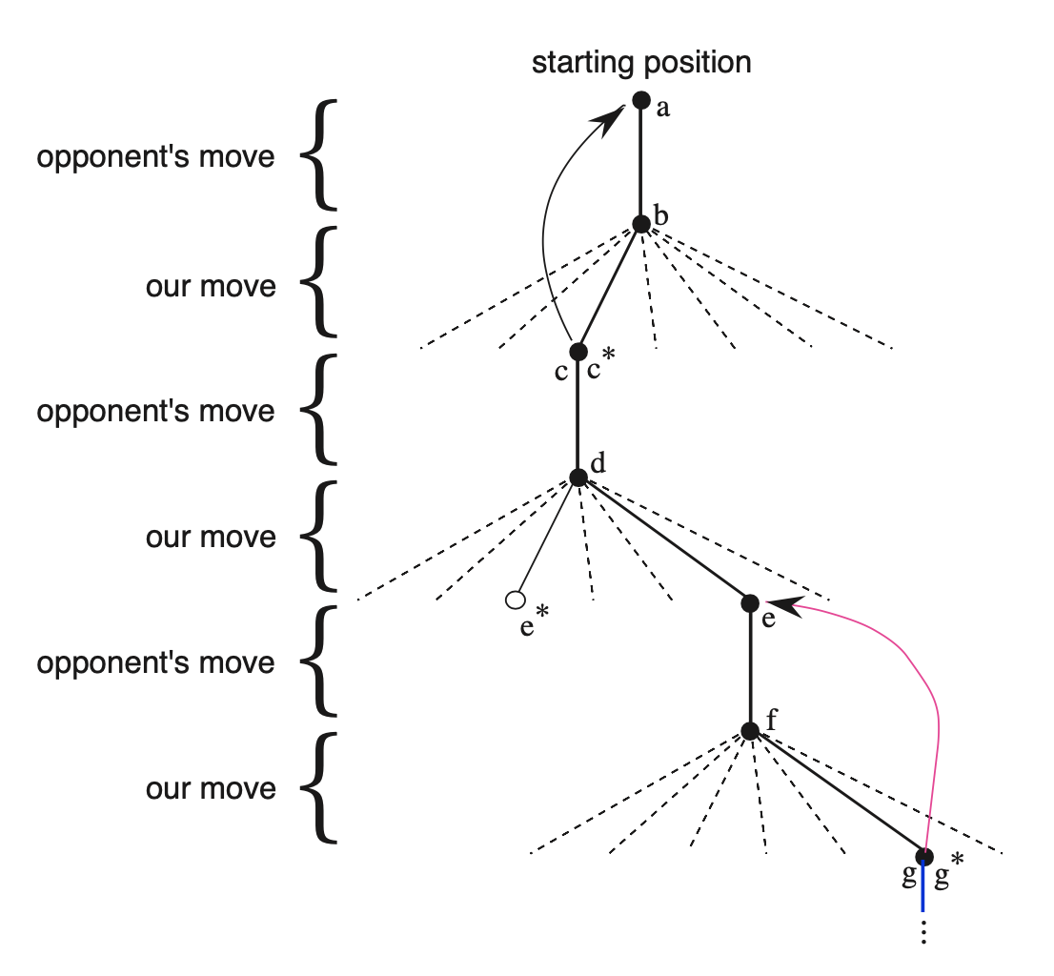
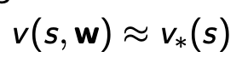
Minimax
Search tree grows exponentially
Impractical to search to the end of the game
Instead, use value approximator
Minimax search to fixed depth
Estimate minimax value at leaf nodes

Slide 31
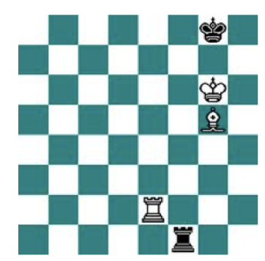
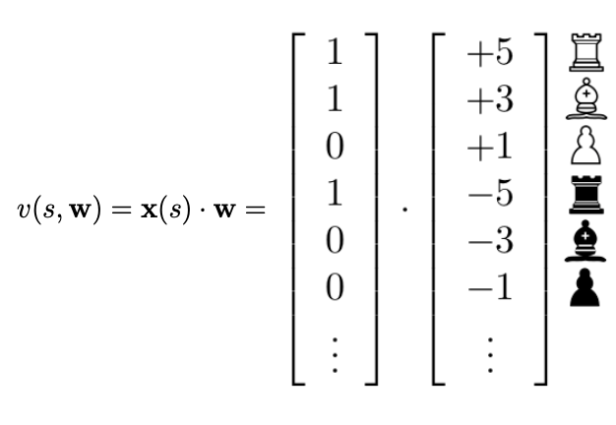
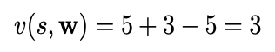
Minimax Example: Chess
Binary-linear value function v(s, w)
Binary feature vector x(s): one feature per chess piece
Weight vector w: value of each chess piece
Position is evaluated by summing weights of current features

Slide 32
Next week
More RL game examples
Rule-based agents and MDPs
Introduction to Deep RL
DeepMind’s RL framework

Slide 33

Questions?

Slide 34
References
DeepMind’s intro to RL videos and slides
https://deepmind.com/learning-resources/-introduction-reinforcement-learning-david-silver
Deep Learning and the Game of Go
https://www.manning.com/books/deep-learning-and-the-game-of-go
Code examples: https://github.com/maxpumperla/deep_learning_and_the_game_of_go
Reinforcement Learning: An Introduction
Richard Sutton and Andrew Barto (2nd ed), https://web.stanford.edu/class/psych209/Readings/SuttonBartoIPRLBook2ndEd.pdf
“An Introduction to Deep Reinforcement Learning”
https://arxiv.org/abs/1811.12560

